Slide 1
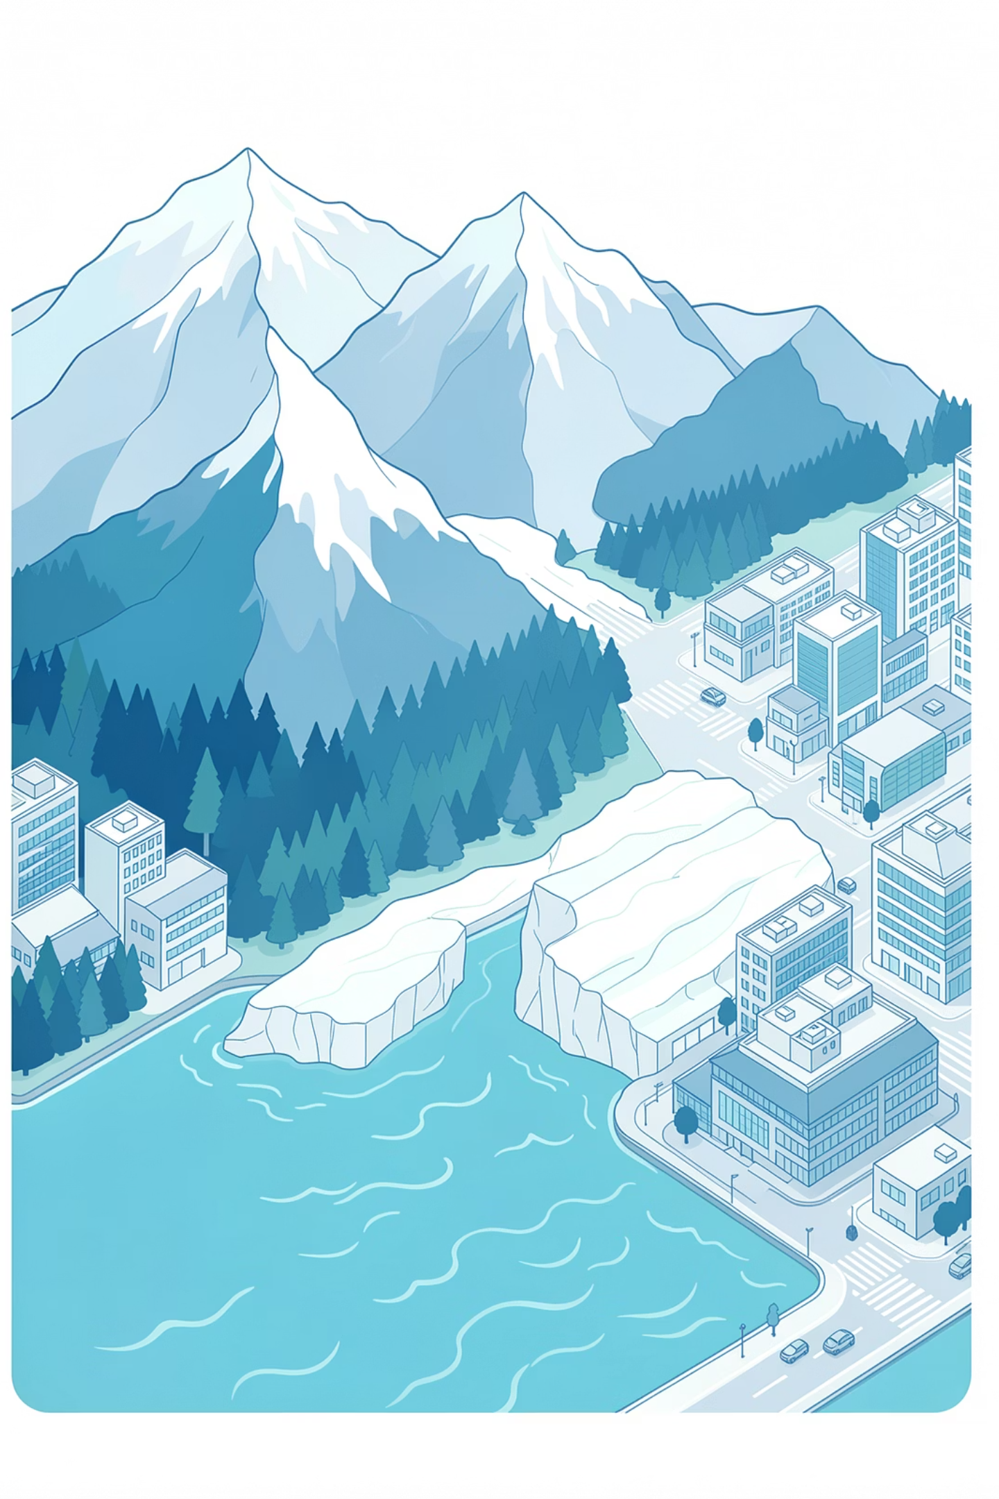
Scene Classification Using Convolutional Neural Networks and Transfer Learning
MODULE 6CS012 - ARTIFICIAL INTELLIGENCE AND MACHINE LEARNING
Group Members
Rajiv Khattri
Binaya Bohara
Unik Ghalan
Assessment
Final Portfolio - Proposal Defense(Task 2)
Academic Year 2025-26

Slide 2
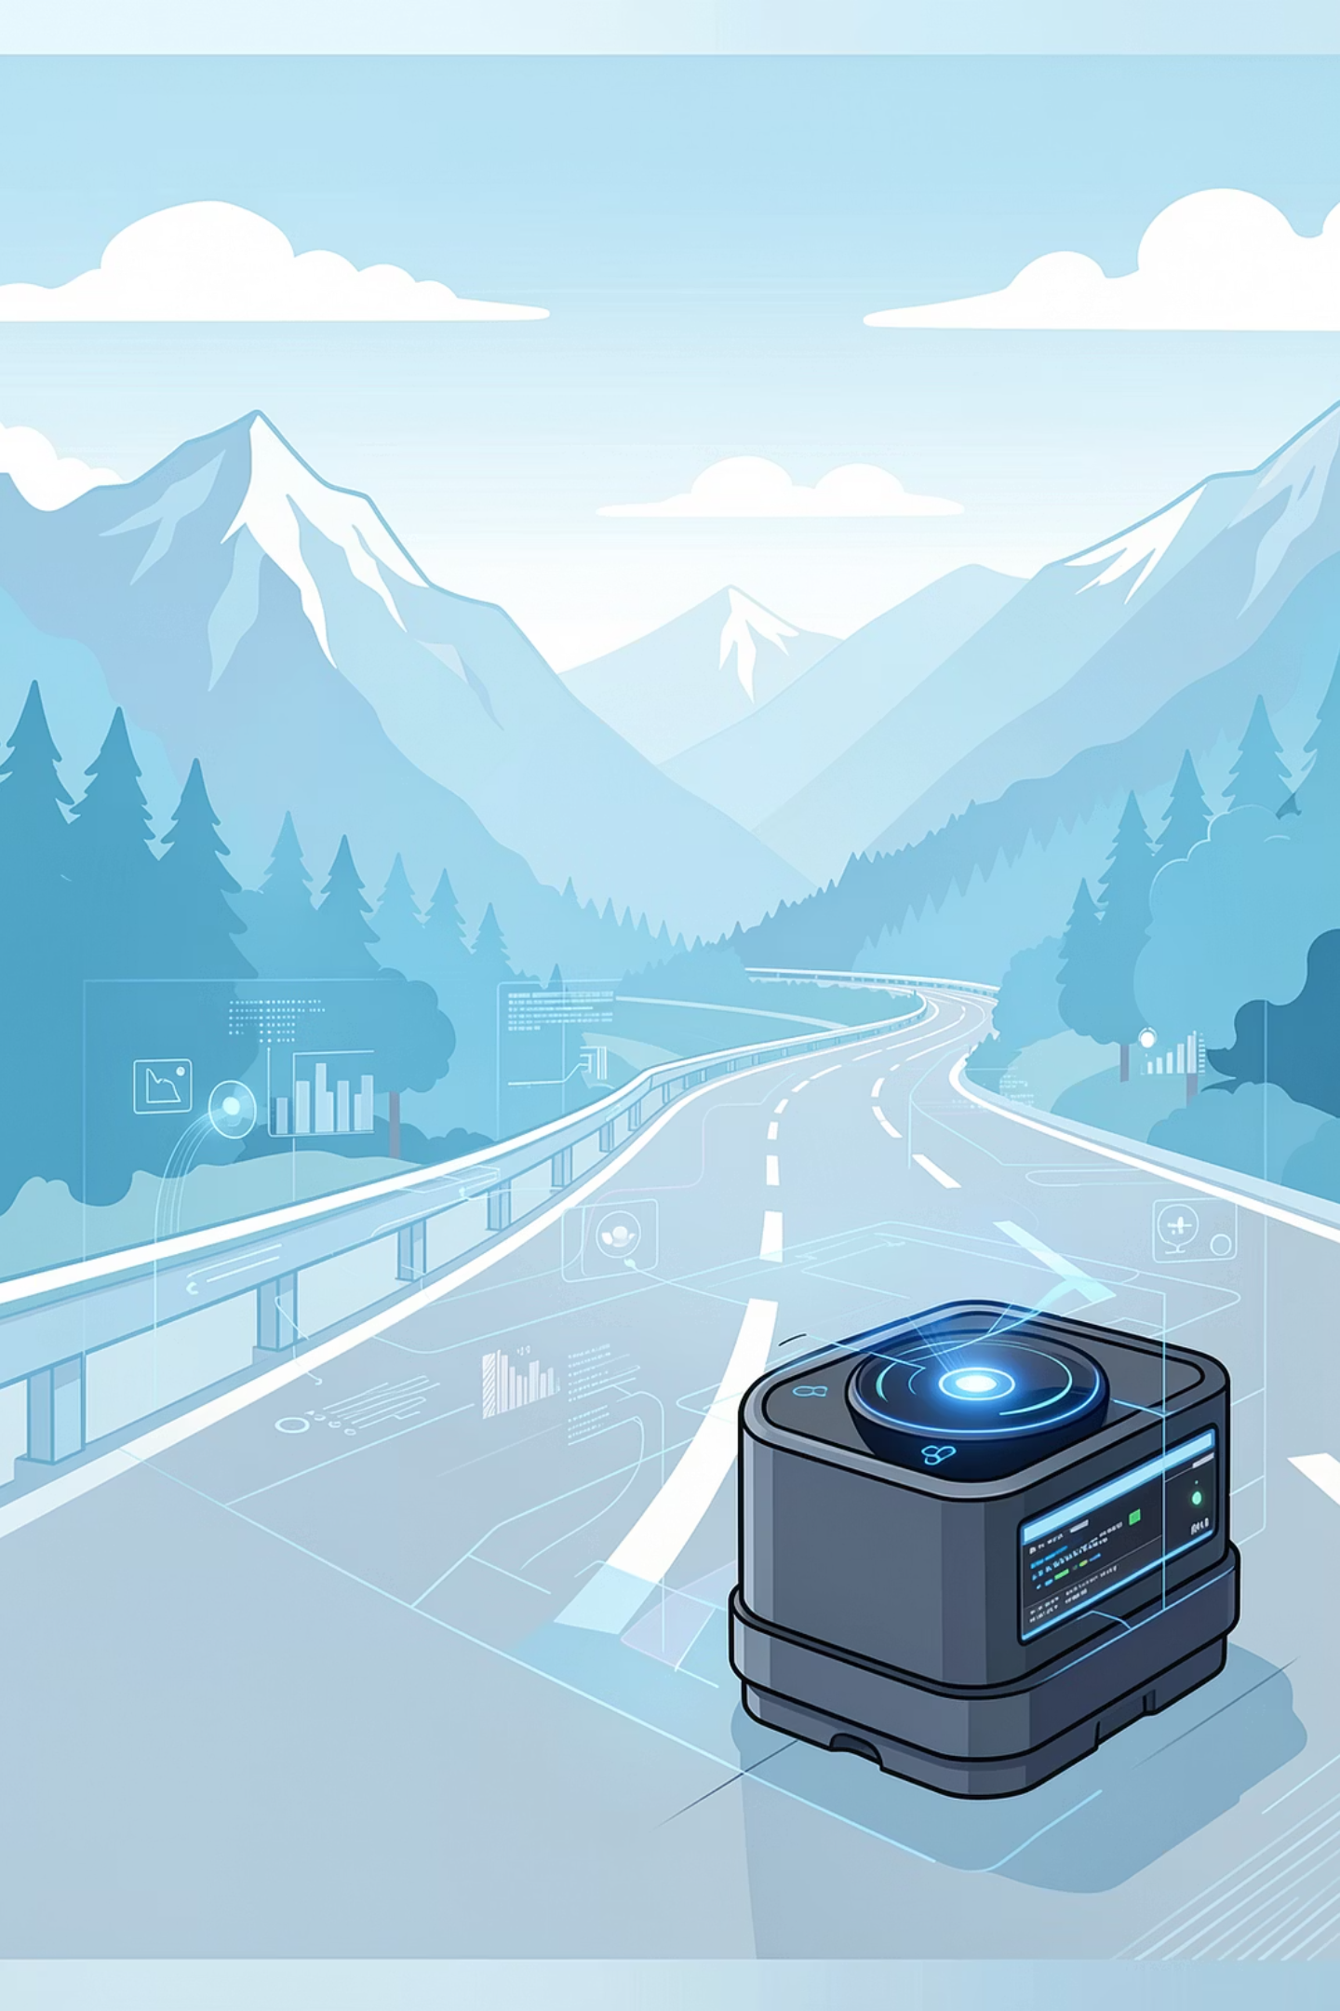
Research Question and Motivation
"Can a Convolutional Neural Network effectively classify natural scenes into 6 categories, and does transfer learning outperform a model trained from scratch?"

Slide 3


Dataset - Intel Scene Classification
SOURCE: INTEL IMAGE CLASSIFICATION DATASET (KAGGLE)
17,034
6
Total Images
Scene Classes
Real-world outdoor scenes
Pre-labeled, balanced split
RGB format · ~150×150 px · Pre-defined train/test split provided with the dataset.
Class
Training
Test
Buildings
2,191
437
Forest
2,271
474
Glacier
2,404
553
Mountain
2,512
525
Sea
2,274
510
Street
2,382
501

Slide 4
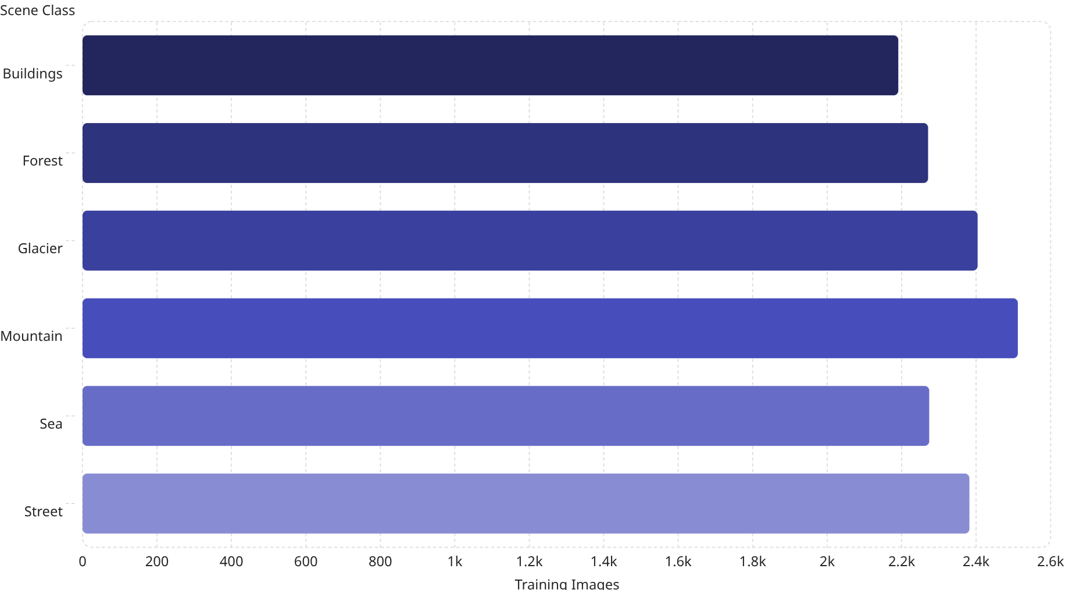

Preliminary Data Analysis
Key Observations
2.19k
2.27k
Near-balanced classes - Mountain (2,512) is only ~15% larger than Buildings (2,191). No class weighting required.
2.4k
2.51k
2.27k
Inter-class similarity - Glacier vs. Mountain and Sea vs. Glacier share color palettes; expect confusion in these pairs.
2.38k
Data quality - A small number of corrupt files(total 42 and 7 in each class) (~10 bytes) exist and will be filtered during loading.

Slide 5


Planned Methodology
Data Preparation
CNN from Scratch
Transfer Learning
Stage 1 - Data Preparation
Stage 2 - CNN from Scratch
Stage 3 - Transfer Learning
Rescale to [0,1], resize to 150×150 (Part A) and 224×224 (Part B). Augment training set: flip, ±20° rotation, zoom, shifts. 20% validation split.
Baseline: 3 Conv+Pool blocks + Dense layers + Softmax. Deeper variant adds BatchNorm and Dropout. Compare SGD vs. Adam; ablation on regularization.
VGG16 (ImageNet, include_top=False, 224×224). Add Dense(256) + Dropout(0.5) + Dense(6, Softmax). Evaluate against Part A.

Slide 6



Initial Observations and Anticipated Challenges
Observations
Anticipated Challenges
Dataset is well-structured with clearly labeled class folders for both train and test splits.
Inter-class confusion - Glacier, Mountain, and Sea share similar textures and color palettes.
Good class balance makes standard accuracy metric appropriate without modification.
Overfitting risk - Deeper CNNs have many parameters; mitigated with Dropout and BatchNorm.
150×150 resolution is suitable for scratch-trained CNNs without excessive compute overhead.
Compute constraints - GPU required; Google Colab (GPU) will be used throughout.
Input size mismatch - VGG16 requires 224×224; images must be resized from native 150×150 for Part B.

